Slide 1
3D Probe Ptychography
Algorithm and preliminary results
Anders F. Pedersen
13-09-2018

Slide 2
Setup
Focused beam (probe): P_{j}
Detector (far field)
Slit in image plane: S
Sample: ρ
Optical axis
2θ
y
x
Objective lens: Aperture: Ap Aberrations: Ab
z

Slide 3
Parameters: Based on 3DBPP
Probe
2D Gaussian (symmetric)
Uniform phase (i.e. probe is real)
Rastered in 2D, perpendicular to the beam direction
Sample
Complex density
Phase inspired from edge dislocation wall
Fixed at central Bragg angle
Objective lens
CRL, N=70, fN=26.5cm
Magnification, M=2
Aperture and aberrations are separated
Aperture is real 2D symmetric Gaussian
Aberration is complex with magnitude 1 and variable phase
Slit
Slit is placed in the image plane
Slit function is 1 inside slit and 0 outside
Slit is uniform along x
Slit is scanned up and down along y

Slide 4

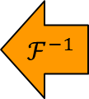
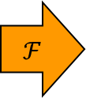












Algorithm: Based on 3DBPP
Sample plane
Objective plane
Image plane
Detector plane
$$ℱ$$
$$ℱ$$
$$ℱ$$
$${\tilde{ψ}}_{j}=\sqrt{I_{meas}}∙\frac{ψ_{j}}{\left|ψ_{j}\right|}$$
$$ψ_{j}=ℛ\left[P_{j}∙ρ\right]$$
$$ψ_{j}=Ap∙Ab∙ψ_{j}$$
$$ψ_{j}=S_{j}∙ψ_{j}$$
$$ℱ^{−1}$$
$$ℱ^{−1}$$
$$ℱ^{−1}$$
$$∂_{j}=P_{j}^{∗}∙ℛ^{†}\left[∂_{j}\right]$$
$$∂_{j}={Ab}^{∗}∙∂_{j}$$
$$∂_{j}=S_{j}^{∗}∙∂_{j}$$
$$∂_{j}=ψ_{j}−{\tilde{ψ}}_{j}$$
$$ρ=ρ−β∙∂_{j}$$

Slide 5
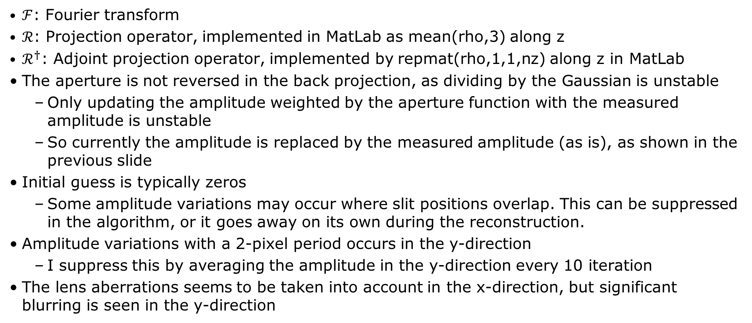
Notes on the algorithm
$ℱ$: Fourier transform
$ℛ$: Projection operator, implemented in MatLab as mean(rho,3) along z
$ℛ^{†}$: Adjoint projection operator, implemented by repmat(rho,1,1,nz) along z in MatLab
The aperture is not reversed in the back projection, as dividing by the Gaussian is unstable
Only updating the amplitude weighted by the aperture function with the measured amplitude is unstable
So currently the amplitude is replaced by the measured amplitude (as is), as shown in the previous slide
Initial guess is typically zeros
Some amplitude variations may occur where slit positions overlap. This can be suppressed in the algorithm, or it goes away on its own during the reconstruction.
Amplitude variations with a 2-pixel period occurs in the y-direction
I suppress this by averaging the amplitude in the y-direction every 10 iteration
The lens aberrations seems to be taken into account in the x-direction, but significant blurring is seen in the y-direction

Slide 6
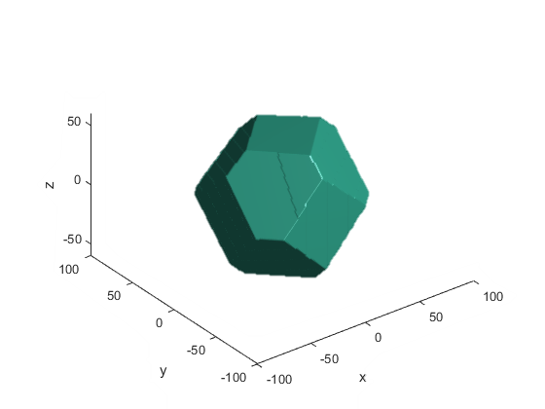
Reconstruction example
Sample
Truncated octahedron
Shape perturbations break symmetry
Phase is uniform along z
Probe
RMS width (intensity): 195 nm
Step size: 172 nm
Slit (dimension relative to sample plane)
Width: 625 nm
Step size: 313 nm
3D probe positions
Only include those with significant intensity
Total of 1651 3D probe positions
Total 100 iterations
Dose: Maximum pixel intensity 1,000,000

Slide 7
Reconstruction example: xy-plane (z = 0)
True amplitude
Reconstructed amplitude
True phase
Reconstructed phase

Slide 8
Reconstruction example: zy-plane (x = 0)
True amplitude
Reconstructed amplitude
True phase
Reconstructed phase

Slide 9
Reconstruction example: zy-plane (x = 20 px)
True amplitude
Reconstructed amplitude
True phase
Reconstructed phase

